Slide 1
Building Apps and Solutions with Microsoft Teams
Notes:
Course title slide

Slide 2



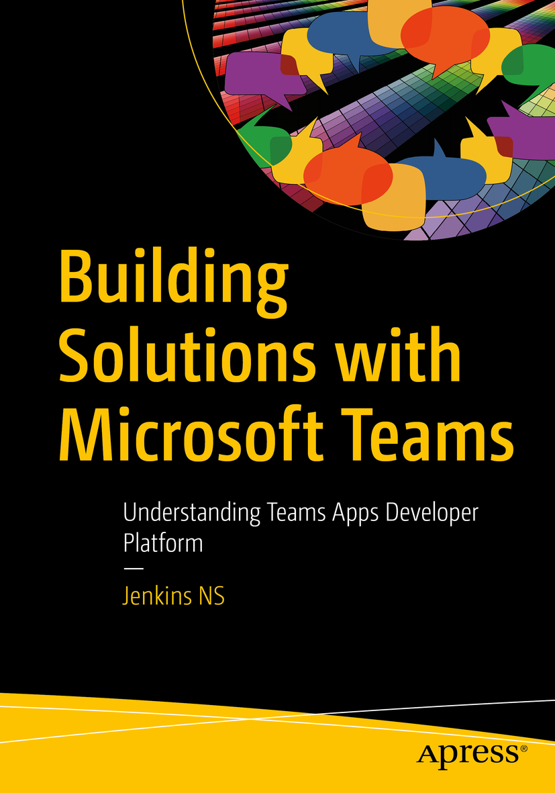











Jenkins NS
Modern Workplace Solution Architect | Consultant
Chennai, India
MVP | MCT | International Speaker | Author | Trainer
Microsoft Teams, Power Platform and SPFx Specialist
M365 Bangalore Organizer
aMS Ambassador
SharePoint-er Since 2005!
@jenkinsns
https://www.linkedin.com/in/jenkinsns/
http://www.jenkinsblogs.com
https://www.youtube.com/user/jenkinsnss

Slide 3
Course agenda
Day 1:
Overview of Teams developer platform
Building scenarios
App Studio
Overview of Teams development technology
Build Tab App - Embedded web experiences with tabs
Overview of Tabs
Tab Layouts
Microsoft Teams Personal Tab
Microsoft Teams Channel or Group Tab
Implement Authentication in a Custom Tab
Using azure AD Authentication
Using Silent Authentication
Using Single Sign On (SSO) Authentication
Delegate Permission
Application Permission
Notes:
Course agenda slide

Slide 4
Day 2:
Bots and Adaptive Cards - Interactive Conversational Bots
Microsoft Bot Framework
Teams Activity Handlers
Bots in Microsoft Personal chat, Channels, and group chats
Proactive Messages
Notifications
Adaptive Cards
Authentication with AAD with SSO
Task Modules – Collect input from user Using Task Modules
Overview of Task Modules
Collect input with Task Modules in Tabs
Deep links in Task Modules
Bots using Task Modules
Authentication with AAD with SSO
Notes:
Course agenda slide

Slide 5
Day 3:
Apps for Teams meetings
Unified meetings apps
Enable and configure your apps for Teams meetings#
Meeting Extension App
Enhanced Collaboration with Live Share
Custom Together Mode scenes in Teams
Messaging Extensions and action Commands
Overview of Messaging Extensions
Action Command Messaging Extensions
Search Command Messaging Extensions
Link Unfurling Messaging Extensions
Connect Web Services to Microsoft Teams with Webhooks
Overview of Web Services and Webhooks
Outgoing Webhooks
Incoming Webhooks
Office 365 Connectors
Notes:
Course agenda slide

Slide 6
Day 4:
Building Teams Apps using Solutions Accelerators
Power Platform (Power App, Power Virtual Agent, Power Automate) integration with MS Teams
Apps Templates
How to deploy App Templates
Teams App Mobile Platform extensibility
SharePoint Framework (SPFx) in Teams
SharePoint and Teams : Better Together
Overview about SPFx (SharePoint framework)
SharePoint framework targeting Teams tabs
Teams Lifecycle management and design Guidance for Apps
Overview to deploy the Apps
Run and debug Your Teams App
Logging Methods
purely local
locally hosted in Teams
Cloud hosted in Teams (Azure Deployment)
AppStore
Best practices
Notes:
Course agenda slide

Slide 7

Hello! Introduce yourself
Let’s get acquainted:
Your name
Title/function
Experience
Your expectations for the course
Notes:
Ask students to introduce themselves and provide their backgrounds, product experience, and expectations for the course.
Record student expectations on a whiteboard or flip chart that you can reference during class.

Slide 8
Closing Slide

